Slide 1

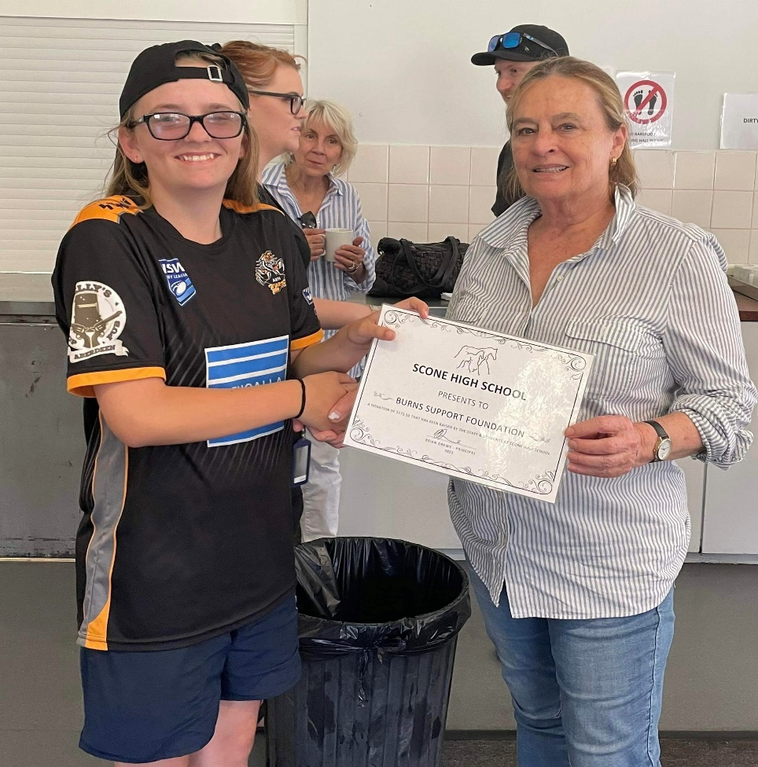
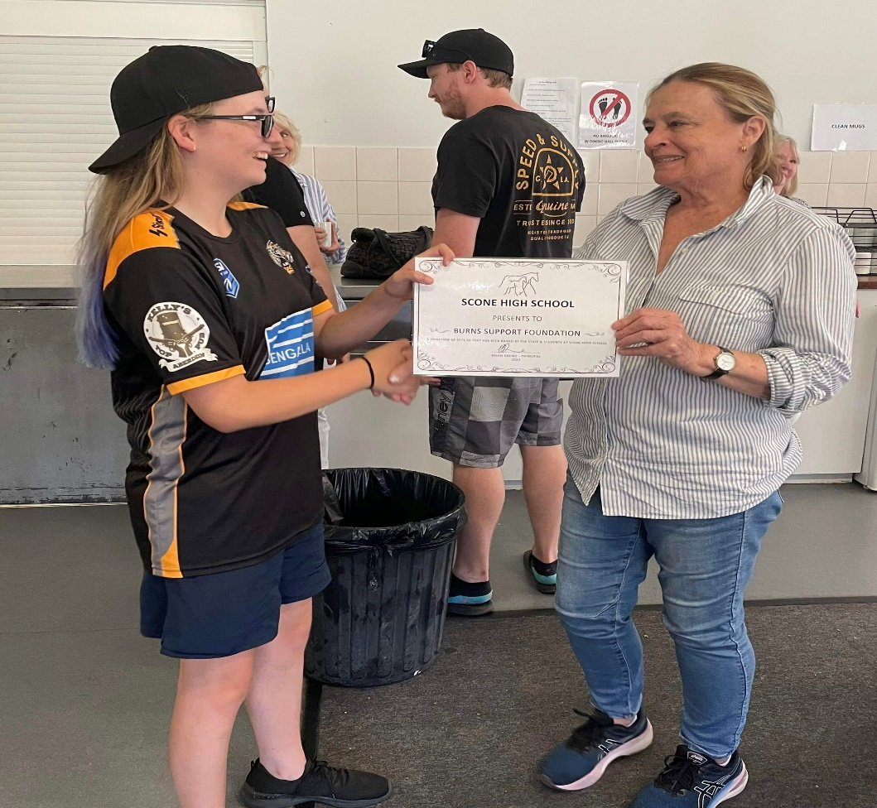
CNF: 13805 | PO Box 476, Paddington NSW 2021 | 0438 906 617
Burns Support Foundation
Issue 33 I March 2023
www.burnssupportfoundation.org.au
info@burnssupportfoundation.org.au
Family Camp – Winter 2023
We were so excited to announce that we will be heading to Wedderburn again for our winter 2023 camp on the 2nd-4th June, some of these activities may include the Flying Fox, Rock Climbing, Low Ropes, Abseiling, Archery, Giant Swing, Giant Pictionary and Support Sessions to be held with Sandra Spalding (Support Coordinator). To register your interest to complete the camp invitation and return by 12th May.
A Generous Donation
A massive thank you to Caroline Orlowsky and Scone High School for your generous donation to our charity. Caroline and Scone High School nominated the burns support foundation as the charity to support which Caroline proudly presented the donation to then President Cheri Templeton at Camp Toukley.
Burns Support Foundation
Become a Volunteer
We are always looking for helping hands so get in touch if you are interested in being part of the team.
Like us on Facebook to keep up to date on all the latest happenings and camp photos.

Slide 2
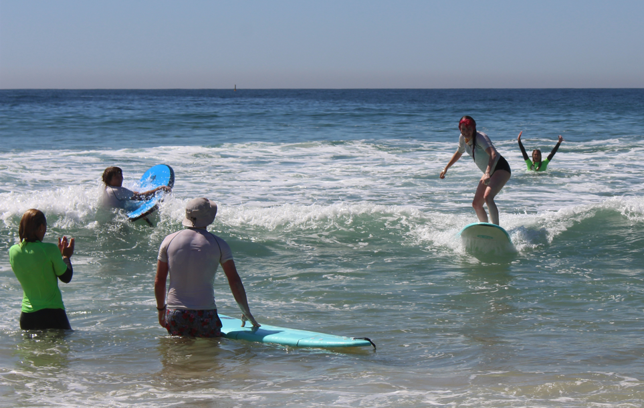
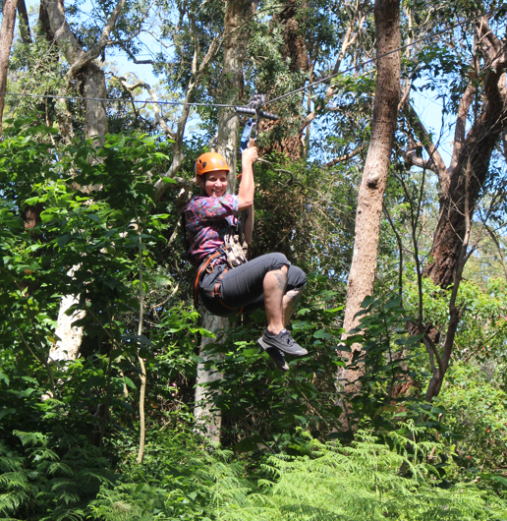
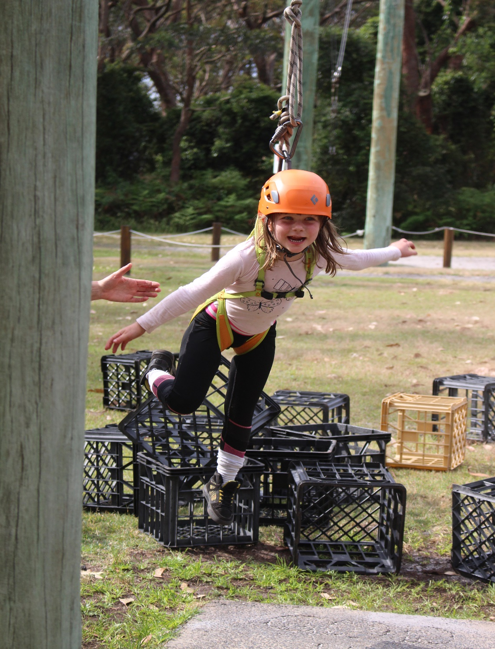

Committee Members
President: Erin Fountain; Vice President: Cheri Templeton;
Junior Vice President: Margaret Jackson; Secretary: Mel Fountain;
Treasurer: Barry Lowe; Camp Coordinator: Margaret Jackson;
Social Media Coordinator: Ashleigh Fountain Support Coordinator: Sandra Spalding
Medical Officer: Hugh Martin Committee Members: Sarah Burrows, Sally Christmas, Elise Burrows, Karen Doyle, Kristy Orlowsky, Destiny Connor
Summer Camp 2022
We headed back up to the Central Coast to Toukley for a fantastic summer camp, we did some fantastic activities which included surfing, paddleboarding, kayaking and the flying fox which everyone really enjoyed, oh and not to forget to mention the create building challenge breaking our own record of 27 creates with a whopping 30 crates, what an incredible effort by all involved.
SAVE THE DATE
I am pleased to announce Summer Camp 2023 has been confirmed for November 10-12 in Toukley NSW
Special Mentions
Congratulations to both Abigail and Jazmine on their engagements, wishing you both and your respective partners a life full of love, happiness and wonderful moments.

Slide 3
INVITATION
Contact Us: 0438 906 617
Family Weekend Retreat
Registered Charity: CNF 13805
Jun 2023
The Burns Support Foundation invites you to the 2023 Winter Family Weekend Retreat for survivors and their family. We have fun and exciting activities on offer, or you may choose quiet relaxation and contemplation. Whatever your preference we guarantee that you will meet some wonderful folk and possibly make some special friends. We aim for an accepting and caring environment.
          Sausage sizzle will be available on Friday from 6pm
The Burns Support Foundation's next family weekend retreat is at:
Wedderburn Christian Campsite
208 Minerva Road, Wedderburn NSW 2508
Friday, 2 June - Sunday, 4 June 2023
http://www.wedderburn.org.au/
Important Information
All meals and activities are included in the cost
CAMP QUERIES: 0438 906 617 or info@burnssupportfoundation.org.au
Adult: 13yrs & up:
Child: 8yrs – 12yrs:
4yrs – 7yrs:
3yrs & under:
$90
$70
$50
Free
SECURING YOUR PLACE: Please complete the form below with the names and age of each family member. Please specify who is the Burn survivor and a contact phone number to reach you on. An Information Pack will be sent upon receipt so get in early and pay your deposit, so you don't miss out on this weekend of fun.
Places are limited so it’s a first in best dressed policy
Non-Related:
Please Note: All forms must be returned prior to the weekend retreat for
processing by 12 May 2023.
12yrs & over:
4 to 12yrs:
$210
$160
Please return the below Application Form: Wedderburn 2023
Please identify who the Burn survivor is by adding a (S) after their name.
Please also add any additional names if required.
Name...........................................................................................................................Age: ..................
Name...........................................................................................................................Age: ..................
Name...........................................................................................................................Age: ..................
Name...........................................................................................................................Age: ..................
Name...........................................................................................................................Age: ..................
Address________________________________________________________________________
Phone number: (H)___________________________ (M)_________________________________
Email Address:__________________________________________________________________
Next of Kin: ________________________________________ Ph: _________________________
Payment
Amount: $_______________________________ being for _________________people.
Please make cheques payable to the Burns Support Foundation.
Or EFT to BSB: 112-879 Account: 155731431. Please ensure you place your name as the reference.
Scan and email to: info@burnssupportfoundation.org.au or please post to PO Box 476, Paddington NSW 2021
Holding Deposit
Deposit $20.00 per person
(NON-REFUNDABLE).
Deposit must be paid by
12 May 2023
Due to high demand, we have limited spaces and can only secure your booking with your FULL deposit. (e.g. Family of 5 people to send $100 as holding deposit).
Room Allocation
Due to popularity, we may ask extended family members to share a room.
Activities
Archery, Giant Swing, Flying Fox, Rock Climbing, Low Ropes, Abseiling, Giant Pictionary, and sessions with Sandra Spalding (Support Coordinator).

